Slide 1

State Quitline Services
2025
Notes:
Good morning all,
Welcome to the QuitLine 101 Presentation for State Quitline Services
For starters I would like to introduce myself – Kiril Harding Client Manager here are RVO Health for the Western Region and I work directly with the Oregon Tobacco Quit Line.
On the call as well we have Camille Kelly she is our Senior Client Manager at RVO Health and will supporting and helping answer any questions for the call.
As far as questions go please leave them till the end – we will have time after the presentation to answer questions.
Lets hop in

Slide 2
1
Quitline Overview
2
Enrollment & Program Design
3
Specialty Tracks
& Priority Populations
4
Referrals
Section Title
Notes:
Here are the topics we will be going over in the presentation today
We will start with a foundational Quitline Overview
And dive into Enrollment & Program Designs
We will then move to Specialty Tracks & Priority Populations
And lastly we will cover referrals

Slide 3


Section One
Quitline
Notes:
Section 1 Quitline
So what is the Quitline?
The Quitline is an integrated telephone, text, chat, and web-based service to support States and programs that are looking to provide commercial nicotine and tobacco cessation services. In addition to coaching, participants of the quitline are given access to a number of supportice resources including QuitGuids and Free NRT. The focus of the Quitline is help particiapnts around quittling commercial nicotine or tobacco use as we do understand some individuals and cultures use tobacco for ceremonial purposes. RVO Health currently serves 22 states and US territories

Slide 4

YOUR SUBTITLE TEXT
What is the Quitline?
Integrated telephone, text, chat & web-based services to support States who want to quit commercial nicotine & tobacco use.
Engagement with local, regional, state & national meetings, trainings & outreach efforts.
Committed to helping all participants quit commercial nicotine/tobacco use through evidence-based treatment including coaching, web support & free NRT.
Telephonic Coaching
Text and Live Chat
Quit Guide
NRT
Section Title
Notes:
So what is the Quitline?
The Quitline is an integrated telephone, text, chat, and web-based service to support States and programs that are looking to provide commercial nicotine and tobacco cessation services.
In addition to coaching, participants of the quitline are given access to a number of supportice resources including QuitGuids and Free NRT.
The focus of the Quitline is help particiapnts around quittling commercial nicotine or tobacco use as we do understand some individuals and cultures use tobacco for ceremonial purposes.

Slide 5

Quit For Life: Changing Lives, Nationwide
22
states and US territories
4.6M
lives helped since 1985
800+
clients across multiple markets
WA
MT
ND
ME
OR
MN
VT
ID
NH
SD
WI
NY
MA
WY
MI
CT
RI
NV
NE
IA
PA
IN
OH
MD
NJ
UT
IL
DE
CA
CO
MO
WV
VA
DC
KS
KY
TN
NC
AZ
NM
OK
AR
SC
MS
AL
GA
TX
LA
GU
HI
FL
PR
AK
Notes:
We currently service 22 states and US territories and have helped over 4.6 million people since 1985. We currenlty also partner with over 800 clients across multiple markets including Managed care organizations, commercial insurance, and employer groups.

Slide 6

Section Two
Enrollment & Program Design
Notes:
Section Two – Enrollment and Program Design

Slide 7
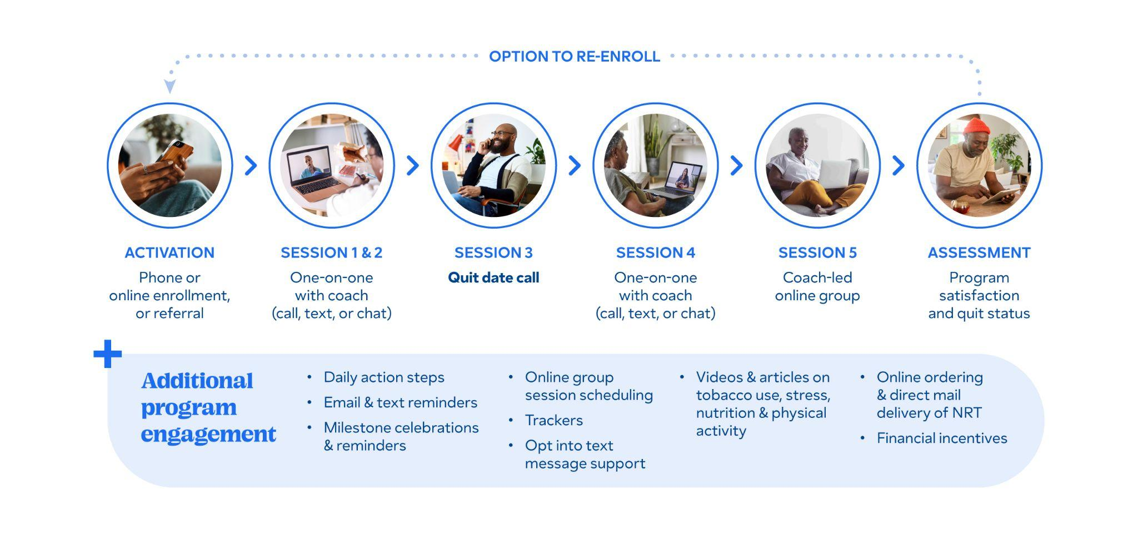
Participant Journey
*Tailored (i.e. Behavioral Health, American Indian, Pregnancy) programs are seven sessions and include five one-on-ones and two group videos
** Members will have flexibility to swap any group video session with a one-on-one session with a coach
Notes:
Participant Journey: From Enrollment to Success
Let's walk through the participant's journey, from their initial contact with our program all the way to their final session and assessment. We'll explore how they progress through key stages, including activation, one-on-one coaching, and optional group sessions.
Stage 1: Activation and Enrollment
The journey begins with activation, where a participant enrolls in the program. They have several options to get started:
Phone Call: The most common method, used by 60-70% of participants, is calling 1-800-QUIT-NOW.
Website: We see about 35-45% of enrollments come through our website (specific website)
Referrals: 5-10% are enrolled through a referral. We'll dive deeper into these referral modalities later in the presentation.
During this 10-15 minute enrollment process, we collect essential data for reporting and program stratification. This allows us to place participants into specialized tracks, such as Pregnancy, Native Quit, Menthol, and Youth programs, which we'll also discuss in more detail later. We also collect their insurance status to determine eligibility for services and Nicotine Replacement Therapy (NRT).
Stage 2: Coaching Sessions
For participants who enroll over the phone, the first coaching call can begin immediately after enrollment, taking another 10-15 minutes. In this initial session, the coach will help the participant:
Set a quit date.
Develop personalized strategies.
Learn evidence-based tools and tactics for quitting.
After the first session, depending on the program offering Coach+ vs Coach (which we will look into further in our call) our team proactively reaches out to participants for subsequent coaching sessions. Participants have the flexibility to engage with their coach via phone, text, or chat, giving them multiple ways to stay connected and supported.
Optional Group Sessions & Additional Support
After their one-on-one coaching, participants have the option to join a coach-led online group session. If a participant prefers, they can continue with individual sessions via phone, chat, or text instead.
At the core of a successful quit journey is the combination of coaching and NRT, which consistently leads to the highest quit rates. Beyond this core combination, we offer a number of additional resources to support participants, including:
Email and text reminders
Dashboard resources – like videos and articles on tobacco use, stress, nutrition, and physical activity.
Daily action steps
One important finding to highlight is our technology-based engagement: participants who were referred to the QuitLine and opted into SMS messaging were twice as likely to enroll in the program.
Final Assessment and Re-enrollment
The journey concludes with a final program assessment, where we measure participant satisfaction and their quit status. Participants also have the option to re-enroll if they need further support.

Slide 8
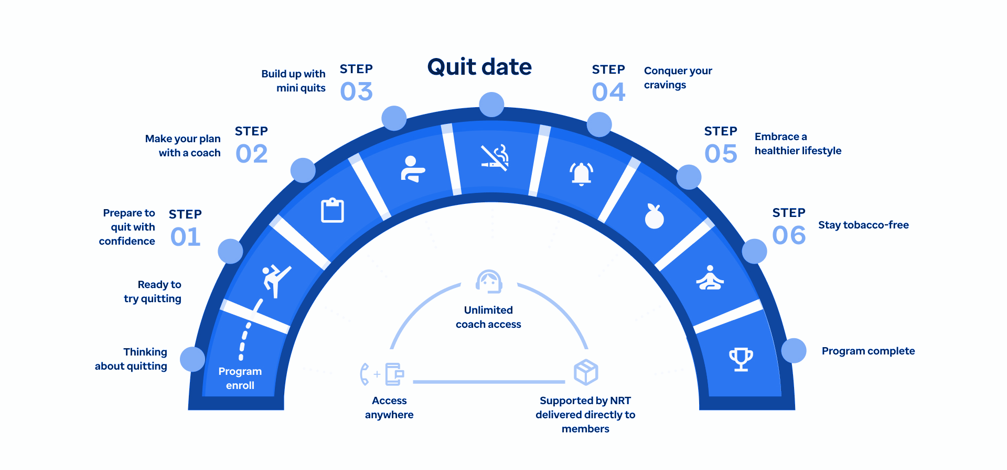
Key Milestones to Quitting
Notes:
Key Milestones to Quitting
This slide illustrates the key milestones of a participant's journey, which are built around our five keys to quitting. You can see how the journey is a progression from preparing to quit all the way to maintaining a tobacco-free life.
Step 1 & 2: Preparing & Planning with a Coach
The journey begins with the initial enrollment and the first two coaching sessions. In these sessions, the coach and participant work together to prepare to quit with confidence.
A key action is setting a firm quit date.
Participants also practice "mini quits" to build confidence. For example, if a participant typically has their first cigarette right after waking up, the coach might encourage them to wait 5-10 minutes each day to practice delaying the urge.
Step 3 & 4: The Quit Date & Conquering Cravings
On or around the participant's quit date, our coaches check in to see how they're doing and address any immediate challenges or cravings they might be facing.
This is a critical point in the journey where we provide real-time support to help them conquer cravings and stay on track.
Step 5 & 6: Embracing a Healthier Lifestyle & Staying Tobacco-Free
The remainder of the program is focused on supporting the participant in maintaining their quit. The goal is to help them embrace a healthier lifestyle and ultimately stay tobacco-free for the long term.
We provide continuous resources and support in case of a relapse or if they need additional help.
Supporting Pillars of the Journey
Unlimited Coach Access: We offer 24/7 unlimited coach access. Participants don't need to wait for a scheduled session to reach out. They can contact a coach at any time with a quick question, even about something as simple as their NRT dosage.
Nicotine Replacement Therapy (NRT): A cornerstone of a successful quit journey is the use of NRT. We believe in its effectiveness, which is why the first shipment is sent to the participant immediately following their enrollment.
This slide visually represents the structured yet flexible support system we have in place to guide every participant toward success.

Slide 9
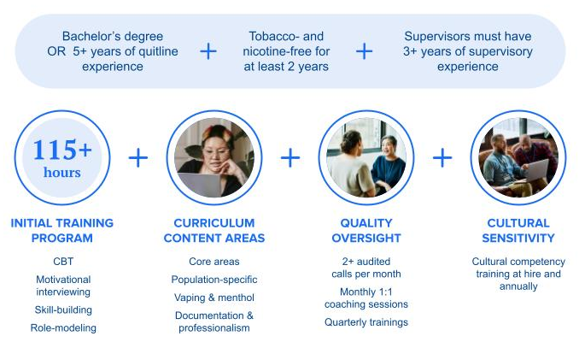
At the Heart of Every Interaction
Notes:
At the Heart of Every Interaction: Our Coaches' Qualifications
Our coaching is effective because of the exceptional qualifications and training of our team, as shown on the slide.
Recruitment & Experience Every coach is highly qualified from the very beginning. They must meet one of the following criteria:
A Bachelor's degree.
5+ years of quitline experience. Additionally, all coaches must have been tobacco- and nicotine-free for at least two years and supervisors must have 3+ years of supervisory experience.
Comprehensive Training Our coaches undergo a rigorous 115+ hour initial training program. This curriculum covers a range of essential skills, including:
Cognitive Behavioral Therapy (CBT) techniques.
Motivational Interviewing, which is key to helping participants find their own motivation to change.
Skill-building and role-modeling.
Ongoing Quality & Sensitivity We ensure the highest standards through continuous training and oversight.
Quality Oversight: This includes 2+ audited calls per month, monthly one-on-one coaching sessions with a supervisor, and quarterly trainings to keep skills sharp.
Cultural Sensitivity: We provide cultural competency training at hire and annually to ensure every interaction is respectful and effective for a diverse participant base.
It's important to understand the key difference between our coaching model and traditional therapy. While participants may have behavioral health conditions, our coaching is highly unique and individualized, focusing on setting and achieving the specific goal of quitting tobacco and nicotine. Coaching is collaborative and goal-oriented. Our coaches work with participants to identify and overcome obstacles, providing guidance and support based on what works best for them. The primary focus is on reaching the goal of quitting. Therapy, on the other hand, is typically focused on exploring and resolving deep-rooted emotional issues or mental health concerns. While we acknowledge that participants may have these challenges, our coaching is specifically designed to help them reach their tobacco cessation goals.

Slide 10
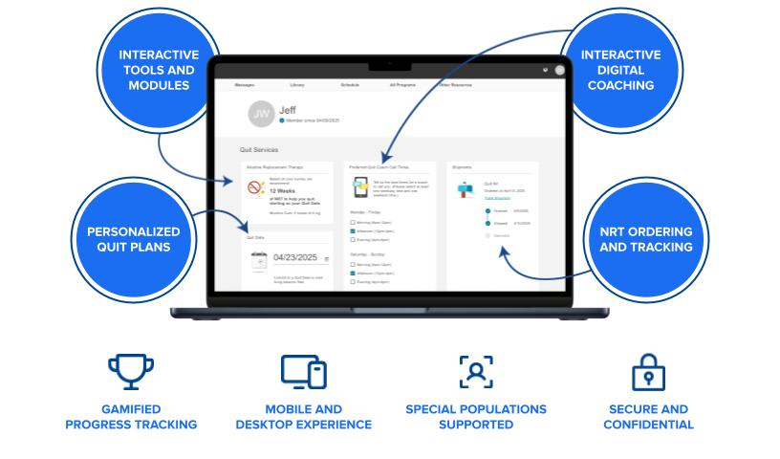
Platform Dashboard
The dashboard provides quick access to State Quit Services resources and tools:
Notes:
The Platform Dashboard: Your Hub for Success
While coaching is the core of our program, our dashboard is the central hub that keeps participants engaged and on track throughout their quit journey. It provides a simple, accessible way for them to manage their progress and access key resources.
Every participant, whether they enroll online or by phone, is given access to this powerful tool. For those who enroll online, they are immediately redirected to the dashboard to begin their journey.
The dashboard offers a comprehensive suite of features to support participants, including:
Personalized Quit Plans: Participants can access and follow their individual quit plan.
Interactive Tools and Modules: The platform is loaded with a variety of interactive resources to keep them engaged.
Interactive Digital Coaching: This offers a seamless digital coaching experience through chat
NRT Ordering and Tracking: Participants can easily manage their Nicotine Replacement Therapy, from ordering to tracking their shipments.
This dashboard is designed to be fully integrated with our coaching sessions. Coaches guide participants to specific resources on the platform based on their conversations, helping them build their toolkit and stay focused on their goals.
Key Features for a Modern Experience
Our dashboard is built with user experience in mind. It is:
Gamified: We use gamified progress tracking to make the journey more motivating and fun.
Flexible: It provides a seamless mobile and desktop experience, so participants can access it anytime, anywhere.
Inclusive: The platform supports our specialized populations, providing tailored resources for each group.
Secure: All data is kept secure and confidential, ensuring a private and trustworthy experience.

Slide 11




NRT Program Offering Options
24/7 ONLINE AND PHONE SUPPORT
3-5
days
ENROLLMENT
EDUCATION
CLINICAL ASSESSMENT
PERSONALIZED NRT SELECTION
ORDER FULFILLMENT
Screen for NRT eligibility and dosing needs
Provide guidance on NRT use and side effects
Identify health risks and obtain provider approval (if needed)
Recommend NRT type and dose
Patch | Gum | Lozenge
Combo: Patch+Gum -or- Patch+Lozenge
Deliver approved NRT within 3-5 days
Notes:
Our NRT Program: Delivering Personalized Support
Nicotine Replacement Therapy, or NRT, is a critical component of our program. We provide a streamlined process to ensure participants receive the NRT they need quickly and effectively.
Step 1: Enrollment & Assessment The process begins during the enrollment call, where we screen for NRT eligibility and assess the participant's dosage needs based on their reported tobacco usage. We always work to maximize the NRT we can provide, following clinical recommendations and state-specific offerings.
Step 2: Education & Clinical Assessment After enrollment, we provide comprehensive education on the proper use of NRT and its potential side effects. A clinical assessment is then conducted to identify any health risks and, if needed, obtain a provider's approval to ensure their safety.
Step 3: Personalized Selection Based on the clinical assessment and the participant's needs, we recommend the most suitable NRT type and dose. Our offerings include:
Patch
Gum
We also provide combo therapy options, such as the Patch-plus-Gum. We know that the best practice for a successful quit is often a 12-week combination therapy, and we work to optimize NRT offerings, especially for participants with limited resources, such as those on Medicaid or Medicare, while respecting program budgets.
Step 4: Fulfillment & Delivery Once approved, the NRT order is fulfilled and delivered directly to the participant's door. We ensure delivery is fast, typically arriving within 3 to 5 business days, so they can begin their quit journey without delay.
Throughout this entire process, participants have access to our 24/7 online and phone support to address any questions they may have.

Slide 12

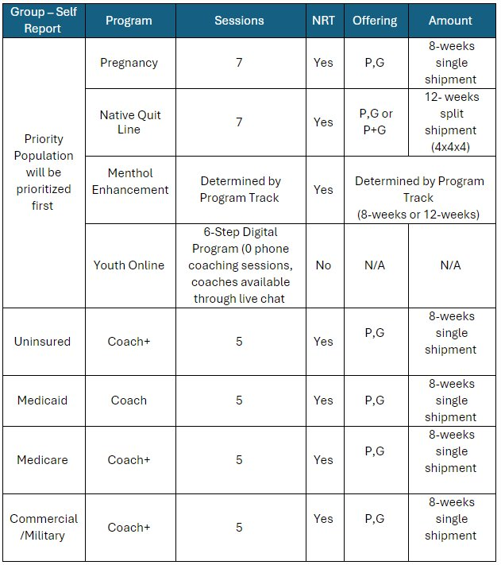
NRT Program Offerings
Notes:
Oregon's Program Offerings: A Breakdown by Track
This table provides a clear overview of Oregon's program offerings, broken down by track. You can see how we tailor our approach based on the participant's specific needs and demographics.
Priority Populations
These tracks are designed for specific groups and are prioritized first.
Pregnancy: This program includes 7 coaching sessions and provides 8 weeks of NRT (Patch or Gum) in a single shipment.
Native Quit Line: This track offers 7 coaching sessions and provides 12 weeks of NRT (Patch, Gum, or a combination) in a split shipment (4 weeks, 4 weeks, and 4 weeks).
Menthol Enhancement: The number of coaching sessions and NRT quantity (8 or 12 weeks) are determined by the specific program track the participant is placed in.
Youth Online: This is a 6-step digital program with coaches available through live chat. There are no phone coaching sessions, and NRT is not provided.
Insured Populations
These tracks are based on the participant's insurance status and include a standard offering.
The biggewst thing to note here is Coach vs Coach+ - Coach plus is the offering that includes the proactive out reach to participants to set up coaching sessions but both coach and coach+ have access to the same amount of coaching sessions phone,. Text or online chat. Online group sessions and unlimited inbound access to coacfhes by phone, text, or chat -
Uninsured: The Coach+ (which includes active outreach for coaching calls) program includes 5 coaching sessions and provides 8 weeks of NRT (Patch or Gum) in a single shipment.
Medicaid: The Coach program includes 5 coaching sessions and provides 8 weeks of NRT (Patch or Gum) in a single shipment.
Medicare: The Coach+ program includes 5 coaching sessions and provides 8 weeks of NRT (Patch or Gum) in a single shipment.
Commercial/Military: The Coach+ program includes 5 coaching sessions and provides 8 weeks of NRT (Patch or Gum) in a single shipment.

Slide 13

Section Three
Specialty Tracks & Priority Populations

Slide 14
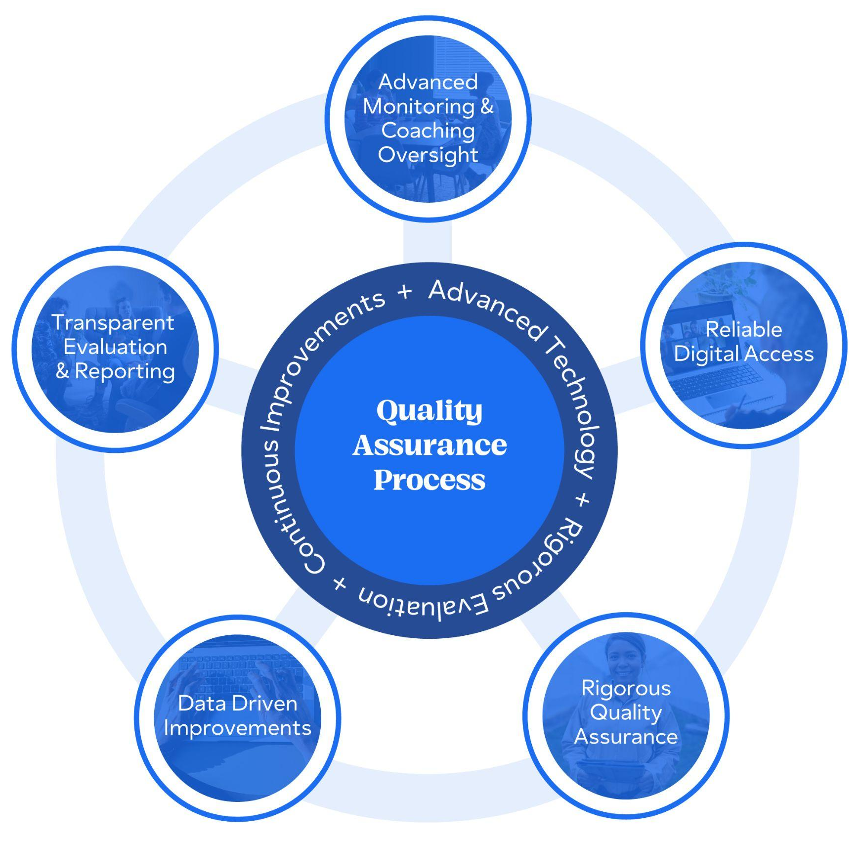
YOUR SUBTITLE TEXT
A Quit Program that Works
How it was developed:
In collaboration with clinical, research, design, and coaching teams:
Program learnings
Research
Client feedback & goals
Coach & member feedback
Program learnings
All Specialty Tracks were developed with the intention to support the unique needs of each population.
Unmatched Quality
Section Title
Notes:
A Quit Program that Works
We know that a one-size-fits-all approach to quitting tobacco doesn't work. To address this, we've developed a program that is truly tailored to the unique needs of specific populations.
How It Was Developed Our programs are the result of a collaborative and evidence-based process. We worked with a wide range of experts, including our state partners, our clinical and research teams, and our experienced coaches, to ensure our programs are effective and culturally competent.
The development process is driven by:
Program learnings from past data.
Rigorous research.
Direct feedback from our clients and our coaches.
This approach allows us to continually update and improve our programs. For example, we are currently doing a major refresh on our behavioral health program to tailor it even more for certain conditions. This enhanced program will be launching soon to provide further specialized support.
This is what makes our approach so effective, and it’s why all of our specialty tracks were developed with the intention of supporting the unique needs of each population.

Slide 15
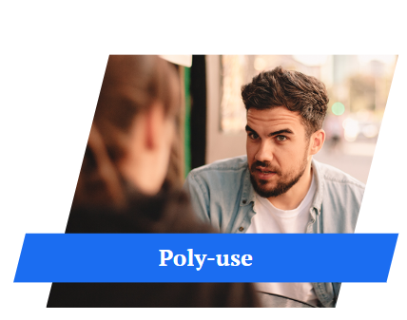



A Custom Experience for Everyone
Quit For Life
Menthol Support
Comprehensive tobacco- and nicotine-quitting program with industry-leading quit rates:
Boosting health, reducing expenses, & improving productivity
For those 13-18, we offer a Youth Online program with coaches abalible through live chat.
Multi-modal support & tailored approach to creating a quit plan that includes:
- 1:1 calls
- Group sessions
- Online web portal
Includes pregnancy-related articles tailored specifically to this audience
Tailored to reach menthol smokers with engaging, actionable content on dangers of menthol, comprehensive medication support
Addresses health equity gaps in underserved communities
Multi-modal support & tailored approach to creating a quit plan that includes:
- 1:1 calls
- Group sessions
- Online web portal
Includes articles tailored specifically to this audience
Addresses individual needs with personalized plans & practical tools
Focuses on additional pre- and post-natal risk
Focus on support from community & differences between ceremonial/commercial tobacco use
Proactive approach to proposed FDA ban on menthol cigarettes
Notes:
A Custom Experience for Everyone
Our standard "Quit For Life" program is a comprehensive, evidence-based program that offers a personalized plan and practical tools to address individual needs. However, we understand that certain populations face unique challenges, which is why we've developed specialized programs to provide a truly custom experience.
Specialty Program Highlights
We offer targeted support for specific groups to boost quit rates and address unique needs:
Menthol Support This program is specifically designed to reach menthol smokers. It provides engaging, actionable content on the dangers of menthol and offers comprehensive medication support. The program takes a proactive approach to the proposed FDA ban on menthol cigarettes and aims to address health equity gaps in underserved communities.
Pregnancy and Postpartum This program uses a multi-modal and tailored approach to help pregnant and postpartum individuals create a quit plan. It includes one-on-one calls, group sessions, and access to an online web portal. The content includes articles specifically tailored to pregnancy-related topics. The focus is on reducing additional pre- and post-natal risks associated with tobacco use.
Native Quitline - Similar to our pregnancy program, the Native American program uses a multi-modal approach with one-on-one calls, group sessions, and a web portal. The key difference is the content, which includes articles tailored to this audience. The program focuses on support from the community and highlights the differences between ceremonial and commercial tobacco use, which is a crucial distinction for this population.
Youth Online Program For participants aged 13-18, we offer a dedicated Youth Online Program. This program provides a complete tobacco- and nicotine-quitting program with coaches available through live chat. The content is specifically adapted for a younger audience with relevant topics and actions that progress through six weekly steps. The program also features engaging elements such as videos, animations, and quizzes to keep teens motivated and on track.

Slide 16


Support for All
Universal Access
Tailored Interventions
Services are available 24/7, free of charge, and accessible, so no one is left behind
Customized for race and ethnicity, disability status, geography, and life experience
Health Equity
Equity-Focused
Clinical Oversight
Specialized approaches for menthol cessation, youth vaping, and challenges faced by LGBTQIA+ individuals
Multilingual Support
Inclusive Training
Coaching and materials are transcreated in multiple languages to better serve diverse populations
Coaches receive training in culture humility, trauma-informed care, and more
Notes:
Support for All: A Commitment to Health Equity
At the core of our program is a deep commitment to health equity. We understand that not everyone's journey is the same, which is why we've designed our services to be as inclusive and accessible as possible. Our approach focuses on three key pillars to ensure no one is left behind.
Pillars of Support
Universal Access:
Our services are available 24/7, free of charge, and accessible to everyone. We believe that cost and convenience should never be a barrier to quitting. We are always on, so participants can reach us whenever they are ready.
Multilingual Support:
To serve our diverse population, our coaching and program materials are translated into multiple languages. Another addion for mutligual support is the language line atha supports participants with over 250 differint launguages available with translators. This ensures that we can effectively support individuals from various backgrounds and linguistic needs. -
Tailored Interventions:
Our services are customized to meet the unique needs of each individual. We take into account factors like race, ethnicity, disability status, geography, and life experiences to provide a truly personalized approach. Our coaches are trained to provide inclusive, trauma-informed care with an emphasis on cultural humility.
Equity-Focused Clinical Oversight
All of these efforts are guided by Equity-Focused Clinical Oversight. This means we are constantly developing specialized approaches for key populations, including:
Menthol cessation.
Youth vaping.
And the unique challenges faced by LGBTQIA+ individuals.
By prioritizing these specialized approaches, we ensure that our program is not only accessible but also specifically designed to help those who need it most.

Slide 17
Section Four
Referrals

Slide 18
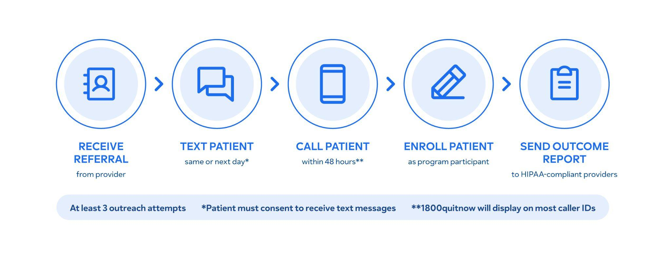
Provider Referral Progression
Notes:
Provider Referral Progression
Our provider referral system is designed to create a seamless and efficient process for referring patients to our quitline. This streamlined approach ensures that a patient who is ready to quit receives timely and effective support, creating a closed-loop system between the provider and our program.
Here’s a step-by-step breakdown of how a referral progresses:
Step 1: Receive Referral
The process begins when we receive a referral from a provider, which can come through various methods, such as fax, an online portal, or an EHR system.
Step 2: Text Patient
Our team takes immediate action. On the same day or the very next day, we text the patient to initiate contact and let them know we will be reaching out. This is a crucial step for engagement, as we know that patients who receive this message are more likely to enroll.
(Note: This step requires the patient's prior consent to receive text messages.)
Step 3: Call Patient
Within 48 hours, we make our first attempt to call the patient.
To build trust and ensure the patient knows who is calling, our number, 1-800-QUIT-NOW, will display on most caller IDs.
We make at least three outreach attempts to ensure we connect with the patient.
Step 4: Enroll Patient
Once we connect, we work to enroll the patient in the program. This conversation typically takes around 10-15 minutes and covers everything from their tobacco use history to their personalized quit plan.
Step 5: Send Outcome Report
The final step closes the loop. We send an outcome report to the referring provider, who receives it through a HIPAA-compliant channel. This report provides them with an update on their patient's progress, allowing for a collaborative approach to care.

Slide 19


Fax Referrals
Fax Number
Text Consent
Remains the same – providers will continue to fax (or e-fax) referrals to 1-800-483-3114
Outcome Modality
Options
As we continue to innovate, we will utilize the ability to text a patient to help increase connection rates and conversion rates
Providers can now choose if they would like to receive a secure email outcome report, a faxed outcome report or no outcome report
Pre Auth NRT
Fax still makes up 37% of all referrals across our book of business.
NPI
Removing barriers from both the patient and the provider, we’ve included the NRT authorization on the fax form
We are now collecting National Provider Identifier (NPI) to allow us to expand reporting options
Notes:
Fax Referrals: Optimizing an Essential Process
While we have diversified our referral methods, fax referrals still make up 37% of our business. We've made several key innovations to this process to improve efficiency, increase conversion rates, and better serve both patients and providers.
1. Streamlined NRT Authorization
To remove a significant barrier for both the patient and the provider, we've included the NRT authorization directly on the fax form. This pre-authorization step streamlines the process and ensures that patients who need NRT can receive it as quickly as possible.
2. Outcome Modality Options
We have also given providers more flexibility in how they receive patient outcome reports. They can now choose to receive a secure email report, a faxed outcome report, or no outcome report at all, depending on their preference.
3. Enhancing Patient Connection
Text Consent: As part of our commitment to innovation, we are now utilizing the ability to text patients who are referred by fax. This helps to significantly increase our connection rates and conversion rates, as we are able to reach patients on a channel they are most likely to respond to.
National Provider Identifier (NPI): We are now collecting the National Provider Identifier (NPI) to allow us to expand our reporting options and make our data more useful for providers.
These updates ensure that our fax referral system remains a vital and highly effective way to connect providers and patients with our program.

Slide 20
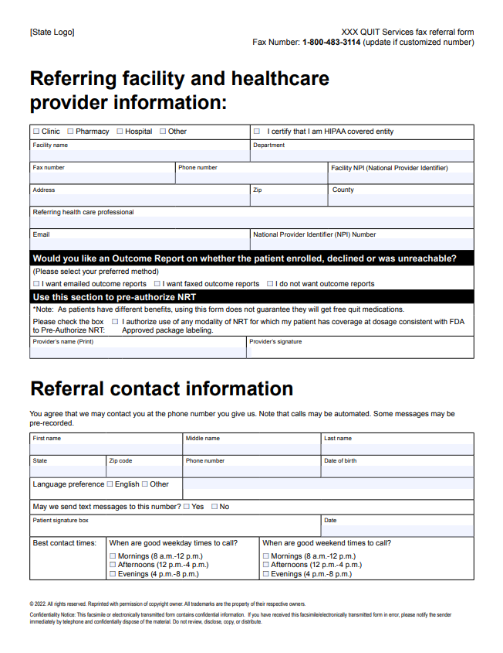
New Referral Form
New categorizing of provider information
New NPI collection
New Pre-Auth NRT feature
New text consent box
Notes:
The New Referral Form: A Focus on Streamlining
This is an image of our new referral form, which incorporates the innovations we just discussed. We've redesigned this form to be more comprehensive and efficient, making the referral process even easier for providers.
Let's highlight the key improvements:
New Provider Information Categorization: We have added new categories for provider information, allowing us to more accurately classify the referring facility as a clinic, pharmacy, hospital, or other. This helps us better understand our referral sources and serve them more effectively.
New NPI Collection: We are now collecting the National Provider Identifier (NPI). This is a crucial addition that allows us to securely send outcome reports to providers and gives us the ability to expand our reporting capabilities in the future.
New Pre-Authorization NRT Feature: You can see the new pre-authorization section for NRT. This allows providers to approve NRT directly on the form, removing a significant barrier and speeding up the process for the patient.
New Text Consent Box: We've also added a new box to the form where providers can obtain and document the patient's consent to receive text messages. This simple addition has proven to be a powerful tool for increasing our connection and enrollment rates.
These updates to our referral form are designed to create a more efficient and effective process for providers and, most importantly, for the patients they refer.

Slide 21

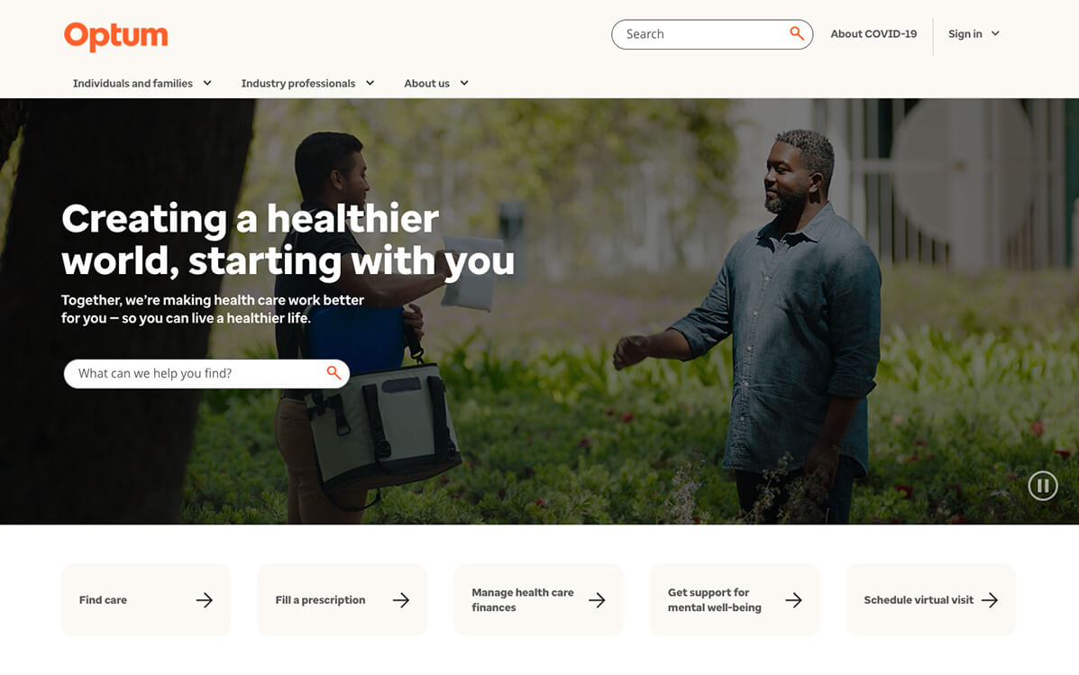
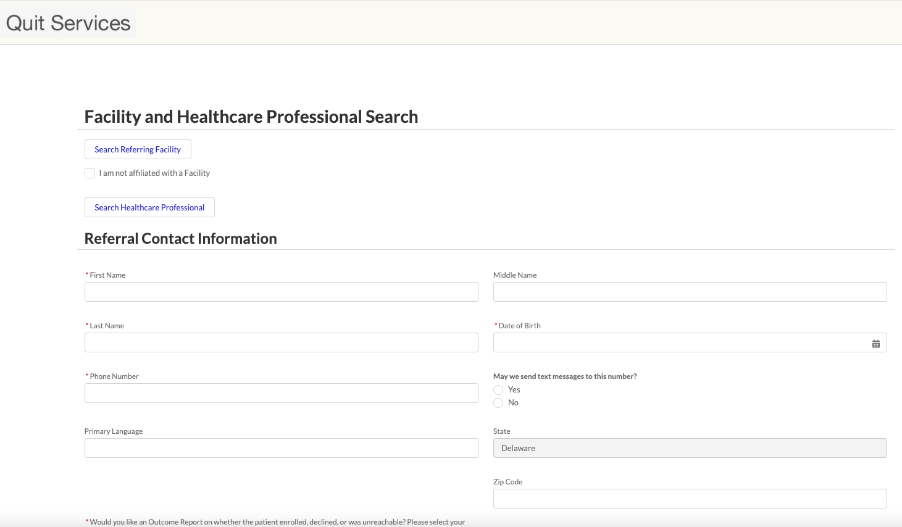
Online Referral Portal
Available for every state at Rally launch
Easy and secure way for providers to refer
NRT Pre-Auth included
Link can be easily shared via QR code and built into state’s website
Real time referral
Easy alternative to EHR or fax
Same outcome report as fax
Notes:
The Online Referral Portal
In addition to our fax referral process, we are proud to introduce our new Online Referral Portal. This tool offers providers a modern and efficient way to refer patients, making the process faster and more accessible than ever.
The portal provides several key benefits:
Universal Availability: The portal is available for every state at the time of our Rally launch, ensuring widespread access for all of our partners.
Easy and Secure: It provides a simple and secure alternative to faxing. Providers can quickly and confidently submit referrals without having to worry about paper forms or outdated technology.
NRT Pre-Authorization: Just like our updated fax form, the online portal includes the option for NRT pre-authorization, which helps to get patients the resources they need faster.
Effortless Sharing: The link to the portal can be easily shared via a QR code and built directly into a state's website. This makes it incredibly convenient for providers to access the referral form from any device.
The online portal delivers a real-time referral experience. It provides an easy alternative to EHR or fax and, most importantly, generates the same secure outcome report as a fax referral, ensuring providers are kept in the loop on their patient's progress.

Slide 22
Overview of E-Referrals
Method​ | Transfer Protocol (HIPAA Compliant) | Benefits​ | Considerations​
Full EHR integration​ | HL7v3 via Direct Secure Message HL7v2 via VPN | HL7* has a set of international standards used across the health industry​ HL7v2 and HL7v3 is a format broadly supported in most known EHR systems (EPIC, eCW, AthenaHealth, etc.)​ | Implementation costs for health systems​ Requires IT and/or EHR vendor involvement​
Notes:
Overview of E-Referrals
Finally, I'd like to briefly touch on E-referrals, which represent the most advanced method of provider referral. We will not be diving too deeply into this topic today, as it is a complex area that could be a full presentation on its own.
E-referrals involve Full EHR Integration, using industry-standard, HIPAA-compliant transfer protocols like HL7v3 via Direct Secure Message or HL7v2 via VPN.
The main benefit of this approach is that HL7 has a set of international standards used across the health industry and is broadly supported by most major EHR systems like Epic, eCW, and AthenaHealth.
The primary considerations for this type of integration are the implementation costs for health systems and the fact that it requires significant involvement from their IT and/or EHR vendor.

Slide 23
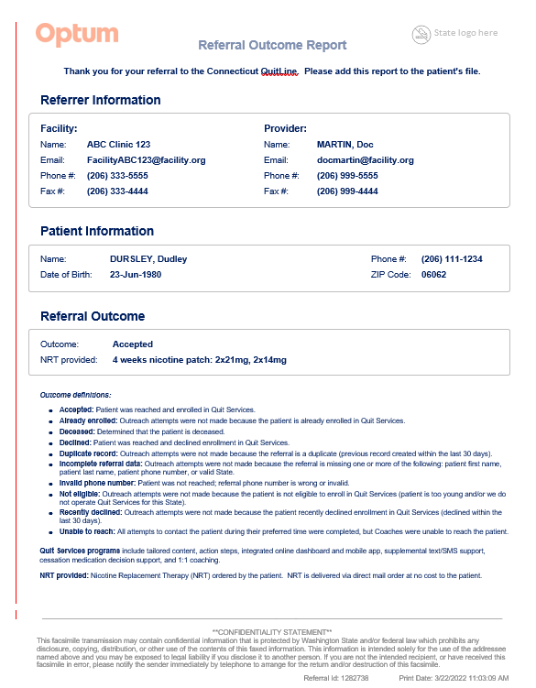
Outcome Report
State logo included
NRT provided
Detailed Outcomes
Notes:
The Outcome Report
The Outcome Report is the final step in the referral process, designed to close the loop with the provider and keep them informed. This report provides a clear and concise summary of the patient's status after we've attempted to contact them.
Key Features of the Report:
State Logo: The report includes the specific state logo, which reinforces the partnership and adds a layer of trust and familiarity for the provider.
Detailed Outcomes: The report provides a detailed outcome of our outreach attempts, using a clear, defined legend. Outcomes include:
Accepted: The patient was successfully reached and enrolled in the program.
Already enrolled: The patient was already a member, so no new enrollment was needed.
Declined: The patient declined to enroll in the program.
And more: Other outcomes detail why we were unable to enroll the patient, such as a duplicate record, invalid phone number, or a patient being deemed too young.
NRT Provided: For patients who enroll, the report specifies the Nicotine Replacement Therapy (NRT) provided. As seen in the example on the slide, it details the type of NRT (e.g., "8 weeks nicotine patch") and the dosage, which is crucial information for the provider.
This report ensures providers have a clear understanding of their patient's journey, allowing for better-coordinated care and a stronger partnership.

Slide 24

Questions?

Slide 25
Thank you!

